Slide 1
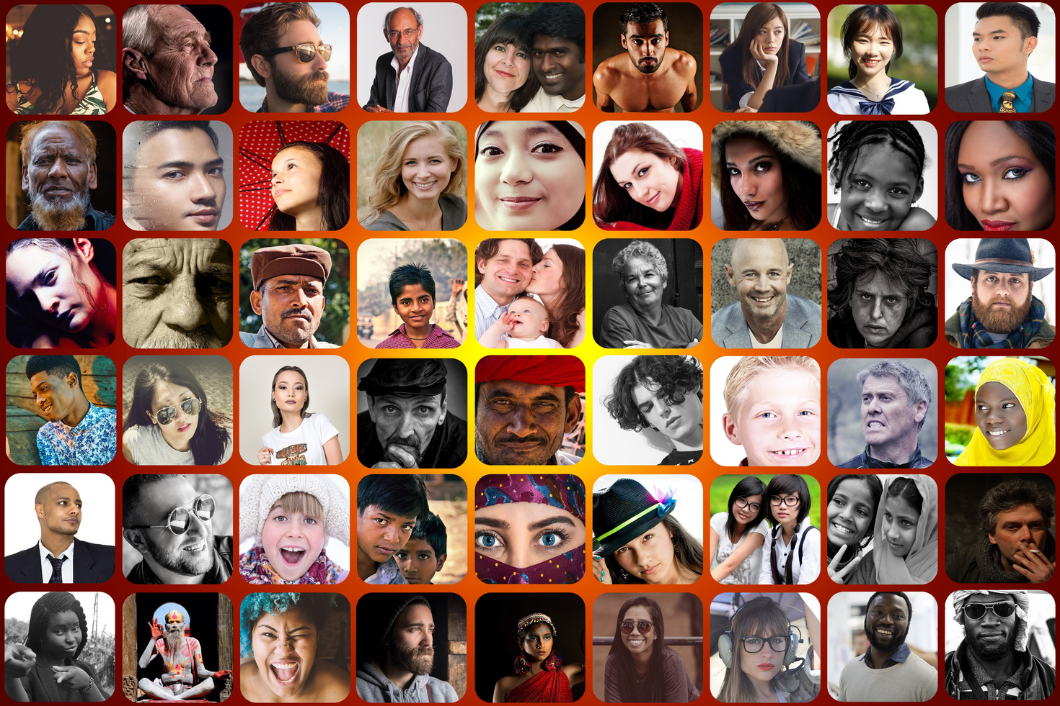
STRUGGLING WITH DEPRESSION OR BIPOLAR?
GET HELP! JOIN A FREE
peer-led support group
Join a community that cares! You are not alone in your struggle with a mood disorder. We've been there, we can help! Our support groups are led by peers who understand firsthand the challenges and can give you resources and support in a safe space. See you there!
SEPTEMBER 20, 2022 (SAMPLE)
6 PM - 8:30 PM
LOCATION
www.dbsacalifornia.org I 408.657.9977

