Slide 1
Online Support Group
The meetings begin at 6:30 pm on
Tuesdays, Fridays and sundays.
See you then

Slide 2
BREATHE
Breath is the bridge that connects life to consciousness.
Use your breath as a means to take hold of your mind again.

Slide 3
Meeting Guidelines
What is said here stays here. (Confidentiality)
It’s everyone’s responsibility to make the discussion group a safe place to share; we treat one another with respect and kindness and show compassion.
We do not diagnose or prescribe – but we can share similar situations and the solutions we have found successful. Peer support can be vital to recovery, as can talk therapy or psychiatry.
Feel free to discuss any issues related to mental health and recovery – please try not to say anything upsetting or triggering to others. (graphic descriptions of trauma, etc.) If a discussion is triggering you or upsetting you, please let the facilitator know, and you can turn off your speakers until we are done with that topic.
Also, please do not eat or smoke on camera, as this can be triggering to some. Also try to avoid controversial subjects
Continued on next page . . . . . . .

Slide 4
Meeting Guidelines, part 2
The facilitator will sometimes mute those who are not speaking to eliminate background noise.
Please be respectful of each other’s time – one person should speak at a time.
With groups larger than 5 people, the facilitator may ask everyone to raise hand (or Zoom hand) to speak, so that everyone is empowered to speak.
If anyone is bothering you, particularly in chat, please report it to a facilitator
It’s OK not to share on any particular subject; only the introduction is required.
We strongly encourage everyone to keep their cameras on.
If you are comfortable doing so, please ensure the facilitator has our email address (in the chat box)

Slide 5
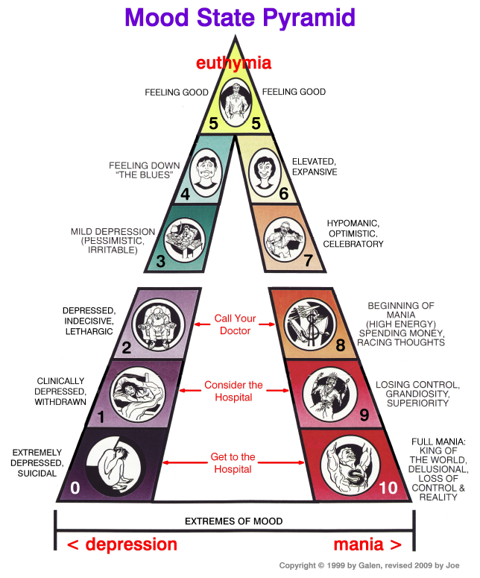
INTRODUCTIONS
Name
Age Range (i.e. “38”, “20-something”, “middle age”)
Location
Scale of 0 to 10
Diagnosis (or primary mental challenge)
Topic for discussion (not necessarily a personal issue)

Slide 6
MEETING SCHEDULE
Assignment of timer (optional)
Note: we do not take breaks, so make your own, if you are thirsty, need a potty break, or whatever. Just step away and come back.
Initial Shares and responses
Open to general discussion (until 8 or 8:30)

Slide 7
SELECTED RESOURCES
http://dbsacalifornia.org/mental-health-resources/

